Slide 1



UNIVERSITY INSTITUTE OF ENGINEERING
COMPUTER SCIENCE ENGINEERING
Bachelor of Engineering
Cloud Computing(CST-411)
Prepared By: Ms Himanshu(E11818)
Topic: Deployment Models of Cloud
Computing
DISCOVER . LEARN . EMPOWER

Slide 2
Learning Objectives & Outcomes
Objective:
To understand the different deployment models of Cloud Computing
Outcome:
Student will understand
Private Cloud
Public cloud
Hybrid Cloud
Community Cloud

Slide 3

Deployment Models

Slide 4
Overview
Deployment Models
Public Cloud
Advantages and Disadvantages of Public Cloud
Private Cloud
Advantages and Disadvantages of Private Cloud
Hybrid Cloud
Advantages and Disadvantages of Hybrid Cloud
Community Cloud

Slide 5
Deployment Models
Cloud Deployment Model defines the type of access to the cloud, i.e., how the cloud is located?
Cloud can be access in 4 types:
Public Cloud
Private Cloud
Hybrid Cloud
Community Cloud

Slide 6
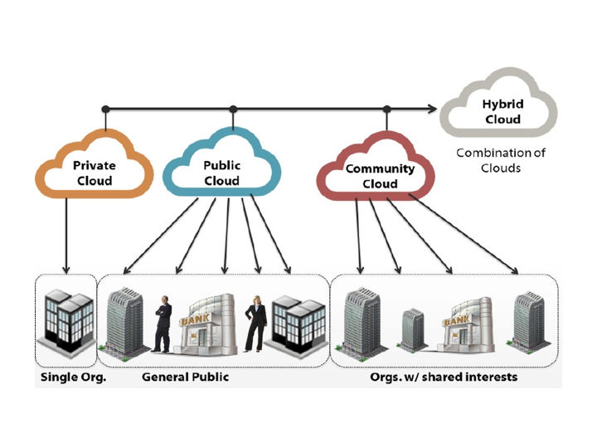
Types of Cloud

Slide 7
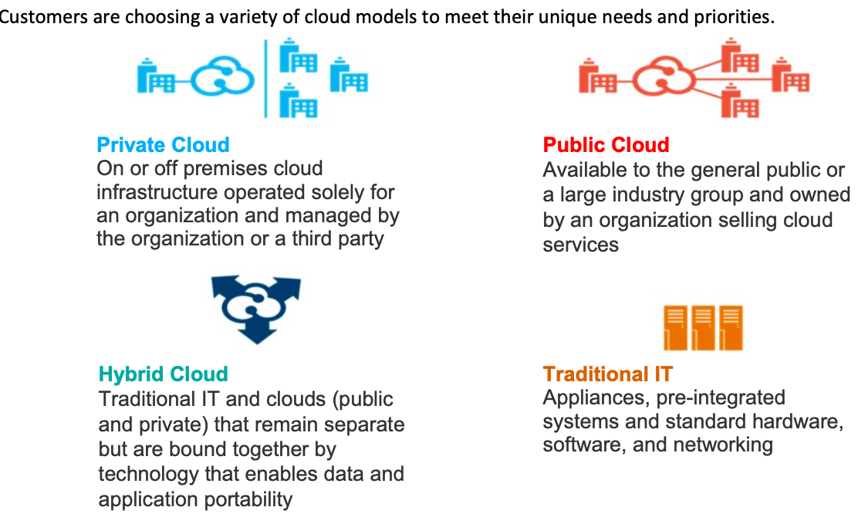
Cloud Deployment Models

Slide 8
Private Cloud
A private cloud is owned by a single organization.
Private clouds enable an organization to use cloud computing technology as a means of centralizing access to IT resources by different parts, locations, or departments of the organization.
When a private cloud exists as a controlled environment, the problems described in the Risks and Challenges section do not tend to apply.

Slide 9
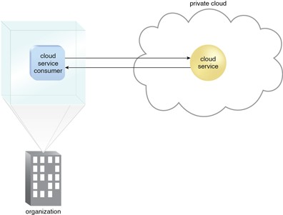

Slide 10
Advantages of Private Cloud
Individual development
Storage and network components are customizable
High control over the corporate information
High security, privacy and reliability

Slide 11
Disadvantages of Private Cloud
Skilled people are required to manage and operate cloud services.
Private cloud is accessible within the organization, so the area of operations is limited.
Private cloud is not suitable for organizations that have a high user base, and organizations that do not have the prebuilt infrastructure, sufficient manpower to maintain and manage the cloud.

Slide 12
Public Cloud
A public cloud is a publicly accessible cloud environment owned by a third-party cloud provide
The IT resources on public clouds are usually provisioned via cloud delivery models .
The cloud provider is responsible for the creation and on-going maintenance of the public cloud and its IT resources.

Slide 13
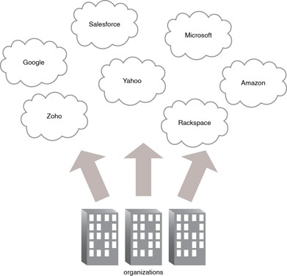

Slide 14
Advantages of Public Cloud
Unsophisticated setup and use
Easy access to data
Flexibility to add and reduce capacity
Cost-effectiveness
Continuous operation time
24/7 upkeep
Scalability
Eliminated need for software

Slide 15
Disadvantages of Public Cloud
Data security and privacy
Compromised reliability
The lack of individual approach

Slide 16
Hybrid Cloud
A Hybrid Cloud is a cloud environment comprised of two or more different cloud deployment models.
Best of both world.
Workload is deployed mostly on private cloud
Resources can be used from public cloud when there is a surge in peak load (Cloud Burst)

Slide 17
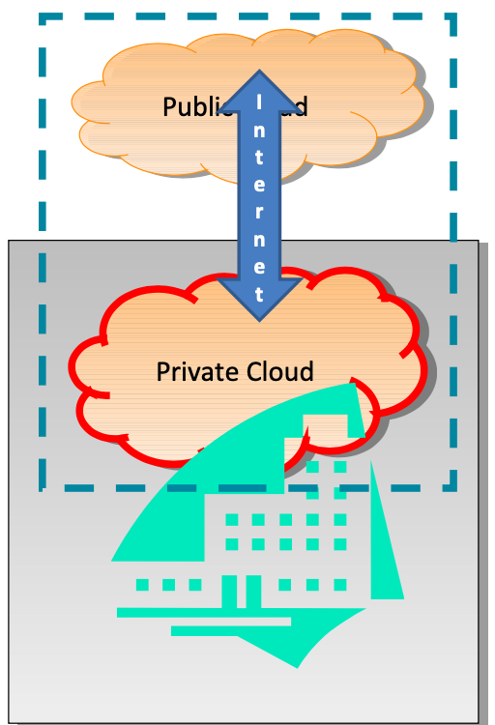

Slide 18
Advantages of Hybrid Cloud
Hybrid cloud is suitable for organizations that require more security than the public cloud.
Hybrid cloud helps you to deliver new products and services more quickly.
Hybrid cloud provides an excellent way to reduce the risk.
Hybrid cloud offers flexible resources because of the public cloud and secure resources because of the private cloud.

Slide 19
Disadvantages of Hybrid Cloud
In Hybrid Cloud, security feature is not as good as the private cloud.
Managing a hybrid cloud is complex because it is difficult to manage more than one type of deployment model.
In the hybrid cloud, the reliability of the services depends on cloud service providers.

Slide 20
Community Cloud
A community cloud deployment model resembles a private one to a large extent; the only difference is the set of users.
While a private type implies that only one company owns the server, in the case of a community one, several organizations with similar backgrounds share the infrastructure and related resources.
As the organizations have uniform security, privacy and performance requirements, this multi-tenant data center architecture helps companies achieve their business-specific objectives.
That is why a community model is particularly suited for organizations that work on joint projects.

Slide 21
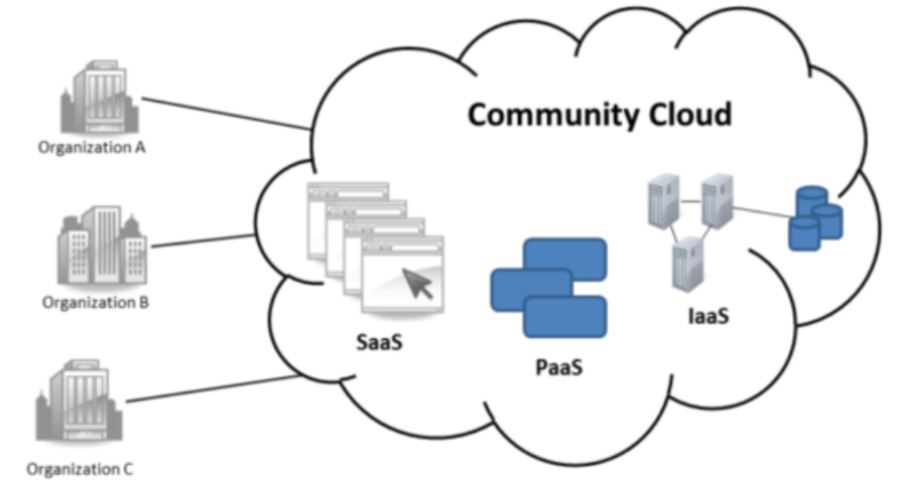

Slide 22
Advantages Of Community Cloud
Community cloud is cost-effective because the whole cloud is being shared by several organizations or communities.
Community cloud is suitable for organizations that want to have a collaborative cloud with more security features than the public cloud.
It provides better security than the public cloud.
It provides collaborative and distributive environment.
Community cloud allows us to share cloud resources, infrastructure, and other capabilities among various organizations.

Slide 23
Disadvantages Of Community Cloud
Community cloud is not a good choice for every organization.
Security features are not as good as the private cloud.
It is not suitable if there is no collaboration.
The fixed amount of data storage and bandwidth is shared among all community members

Slide 24
Parameter | Public Cloud | Private Cloud | Hybrid Cloud | Community Cloud
Host | Service provider | Enterprise (Third party) | Enterprise (Third party) | Community (Third party)
Users | General public | Selected users | Selected users | Community members
Access | Internet | Internet, VPN | Internet, VPN | Internet, VPN
Owner | Service provider | Enterprise | Enterprise | Community

